Slide 1

Welcome
to the

Slide 2

Services offered:
RG TECH Solutions is one of the leading multi-disciplinary Technology solution providers with comprehensive professional experience in the following sectors:
LAN, WAN, MAN [Wired & Wireless] Projects for Urban and Regional Planning, integration and Infrastructure Development.
Long Distance Data, MPLS/ IP VPN Carrier provisioning Services
Security, Surveillance & Automation solution for Commercial, Industrial and Residential buildings.
Tower & Antenna erection
Vehicle tracking for large Fleet operators.
Solutions for IT, BPOs,
Client oriented IT/ Networking related services.
Video Conferencing
Website Development

Slide 3
Company’s competence:
Planning and Feasibility Studies
Traffic and Transportation Studies
Investigations including Geo-technical Investigations, Design, Project Preparation and Cost Estimation.
Techno-Economical Analysis.
End-to-end Project Implementation & Commissioning.
Acceptance Testing.
Network monitoring, Maintenance & Servicing.
Technical Inspections/ Audits.
Network up-gradation.
Human Resource Development and Institutional Development.
RG Tech solutions has established a reputation for its sustained quality, innovative and cost effective design and planning methodologies, adoption of state-of the art technology and strong client – orientation.

Slide 4
Index :-
Please click the links to choose the subjects you are most interested in
Or
Move the down button for complete viewing:
→ Networking your Business
→ Wi-Fi Solutions
→ Leased Line Data/ MPLS- IP VPN Circuits
→ Surveillance & Security Automation Solutions
→ Tower- Antenna Works
→ Vechile Tracking solutions
→ IT, BPO Solutions
→ Technology

Slide 5
Networking your Business
Increase the efficiency of your daily business activities!
Automating business processes requires the right network design for your company or organization. By working with you to understand your company’s goals and vision we can provide you with a network design that is going to work for you today and grow with you tomorrow.
Giving you all the keys to unlock today’s technology to employ the latest in:
LAN/WAN infrastructure and connectivity
Wireless networking for LAN and WAN
Network Security/ Firewalls
System Integration and Supports.
MPLS VPN/ IP VPN
Internet Solutions.
Voice Over IP (VoIP)
Previous Slide
Back-2-index
Next Slide

Slide 6
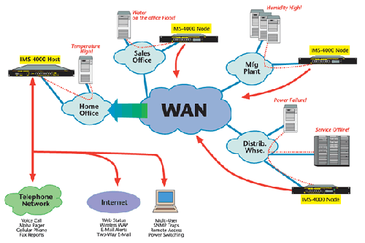
Wired network structure
Previous Slide
Back-2-index
Next Slide

Slide 7
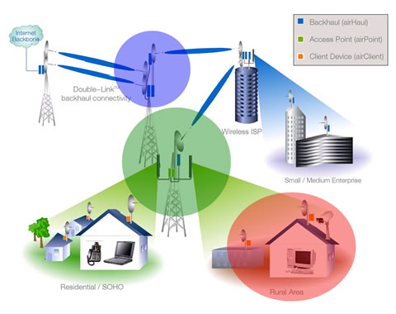
Wire-less network structure
RF Back up for Wired net work & Automatic Switch over to RF in the event of normal OFC link fails: - Solutions offered by us.
Previous Slide
Back-2-index
Next Slide

Slide 8
VoIP
Voice over Internet Protocol (VoIP), is a technology that allows you to make voice calls using a broadband Internet connection instead through a normal phone line.
Some VoIP services may only allow you to call other people using the same service, but others may allow you to call anyone who has a telephone number - including local, long distance, mobile, and international numbers.
Also, while some VoIP services only work over your computer or a special VoIP phone, other services allow you to use a traditional phone connected to a VoIP adapter.
Previous Slide
Back-2-index
Next Slide

Slide 9
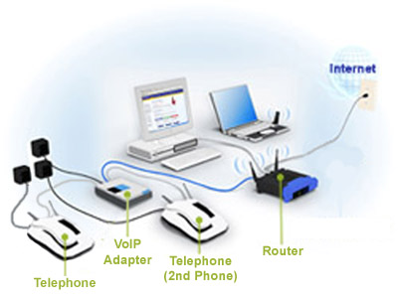
VoIP Diagram
Previous Slide
Back-2-index
Next Slide

Slide 10
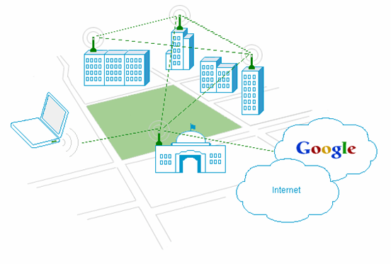
Wi-Fi
Wi-Fi, which stands for wireless fidelity, in a play on the older term Hi-Fi, is a wireless networking technology used across the globe as per IEEE standards: 802.11
The wireless networking technology uses radio waves to provide wireless high-speed Internet and network connections.
Previous Slide
Back-2-index
Next Slide

Slide 11
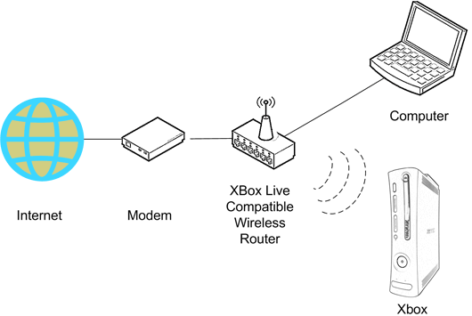
Wi-Fi
The purpose of Wi-Fi is to hide complexity by enabling wireless access to applications and data, media and streams. The main aims of Wi-Fi are the following:
make access to information easier
ensure compatibility and co-existence of devices
eliminate cabling and wiring
eliminate switches, adapters, plugs, pins and connectors.
Previous Slide
Back-2-index
Next Slide

Slide 12
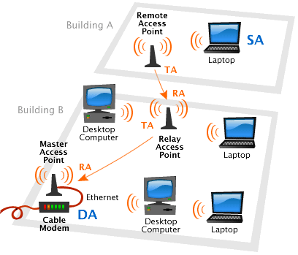
Wi-Fi
Previous Slide
Back-2-index
Next Slide

Slide 13
Long Distance Data Circuits
Telecommunication Carrier Services
Previous Slide
Back-2-index
Next Slide

Slide 14
Leased Line-(Data Circuit)
A permanent telephone connection between two points set up by a telecommunications common carrier.
Typically, leased lines are used by businesses to connect geographically distant offices.
Unlike normal dial-up connections, a leased line is always active. The fee for the connection is a fixed monthly rate.
The primary factors affecting the monthly fee are distance between end points and the speed of the circuit.
Because the connection doesn't carry anybody else's communications, the carrier can assure a given level of quality.
Previous Slide
Back-2-index
Next Slide

Slide 15
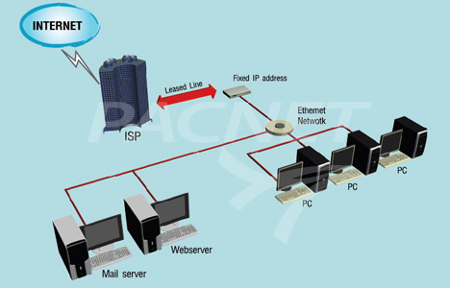
Lease Line Setup
Previous Slide
Back-2-index
Next Slide

Slide 16
ISDN PRI (Primary Rate Interface)
A PRI (Primary Rate Interface) is a telecommunication standard used in the Integrated Services Digital Network or ISDN, for carrying multiple DS0 voice and data transmissions between two physical locations. PRI was developed specifically for industrial or large quantity users. PRI is an industrial ISDN line while the Basic Rate Interface, or BRI, is used to cater to home and small enterprises.
Previous Slide
Back-2-index
Next Slide

Slide 17
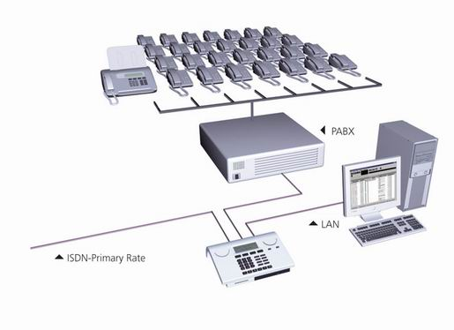
ISDN PRI Call Setup/Teardown
SETUP
SETUP ACK
(CALL PROCEEDING)
(ALERTING )
CONNECT
CONNECT ACK
Talk
DISCONNECT
DISCONNECT ACK
ISDN PRI setup
Previous Slide
Back-2-index
Next Slide

Slide 18

MPLS-VPN
MPLS stands for "Multi-Protocol Label Switching" packet-switching VPN technology. After MPLS VPN is used, incoming data packets are assigned a "label" by a "label edge router (LER)". Such labeled packets are forwarded along a "label switch path (LSP)". Along a LSP, each "label switch router (LSR)" forwards a packet based solely on the instructions of the label.
Simple MPLS-VPN network
Diagram
Previous Slide
Back-2-index
Next Slide

Slide 19
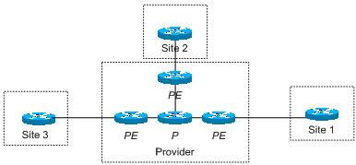
MPLS VPN Technique
A typical MPLS VPN will be acting as though it is one big router in the middle of your network.
The MPLS cloud is made up of devices known as P (provider) routers and PE (provider edge) routers.
Three sites connected to MPLS cloud
Previous Slide
Back-2-index
Next Slide

Slide 20
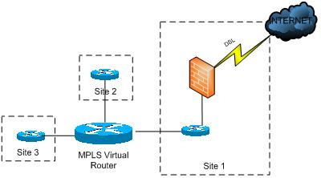
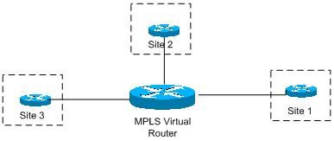
Setup
The P and PE routers together can be treated like one big router as shown above.
internet access from sites attached to the MPLS network, there are a few other things to consider.
you could install a DSL circuit into each site. Another, more effective solution is to install a single, larger, internet connection into one site.
Previous Slide
Back-2-index
Next Slide

Slide 21
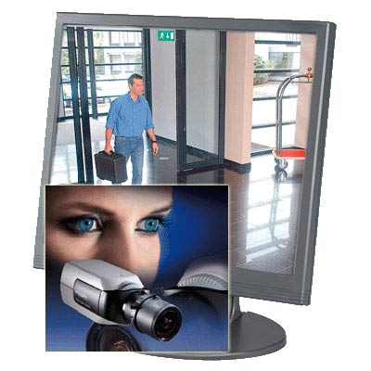
Surveillance & Security Solutions
[Visual Monitoring and Fire alarm systems for Prevention & Protection]
We provide integrated Solutions for:
Commercial Houses/ Malls
Industrial establishments
Star Hotels/ Restaurants
Government facilities
Educational institutions
Law enforcement authorities
Prisons
Apartments/ Flats
Residential Houses/ Villas
Prevention is better than Cure
Previous Slide
Back-2-index
Next Slide

Slide 22
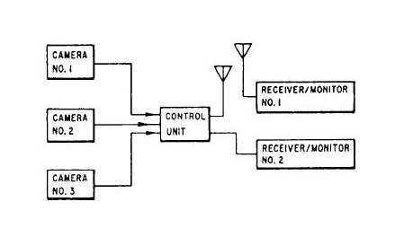
CCTV:
Closed Circuit Television. A television system used for private purposes and not for public or general broadcast.
A video monitoring and security system used to provide continuous traffic monitoring by the facility operator along the length of the facility and particularly at points of entry and tolling locations.
Previous Slide
Back-2-index
Next Slide

Slide 23
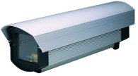



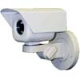
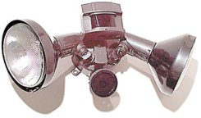

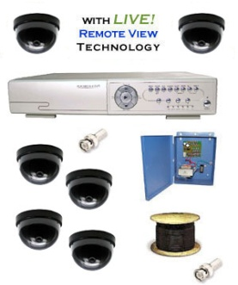

Types Of CCTV
Cameras:
Dome cameras
Wall cameras
Hidden cameras
IR Camera
Mini Cams
Body Type Came
IP Cameras
Zoom Cam
Dome camera
Wall cameras
Hidden cameras
Previous Slide
Back-2-index
Next Slide

Slide 24
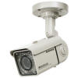
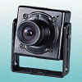


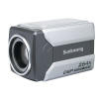
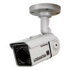
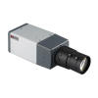
IR & IP Cameras
Body Type Came
IR LED Day/Night Cameras
Mini Cam
Zoom Cam
IP Cameras
Previous Slide
Back-2-index
Next Slide

Slide 25

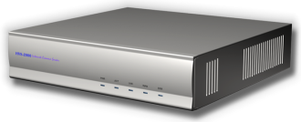
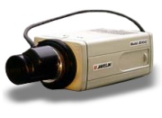
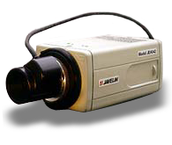
CCTV Configuration
CCTV network uses UTP cables to ensure fast transmission of mass data
CCTV network is connected with LonWorks network for data transmission
Monitor (4 screens)
VIDEO MATRIX
DVR
E/LX7
10X2 1F - 2F
4X17 3F-19F (A,B Lift corridor)
10 (Outside building and roof）
10X3 B1-B3(Parking lot)
Previous Slide
Back-2-index
Next Slide

Slide 26
Configured CCTV System:
Monitors and reacts to emergencies which may happen in the following areas:
- In the lifts, roof
- Lift corridor of each level
- Underground parking lot, driveway and footpath
- Outside areas of the building
24 hours video recording
Digital video recording = long recording hours, easy management
Previous Slide
Back-2-index
Next Slide

Slide 27
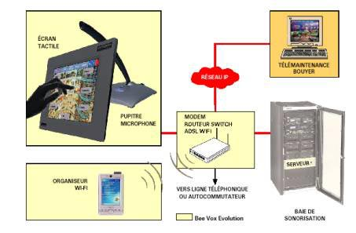
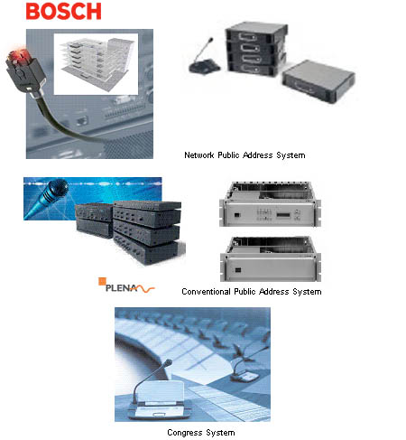
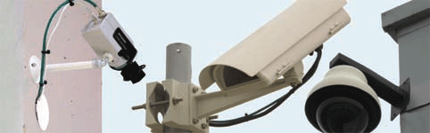
PUBLIC ADDRESS SYSTEM :- IP BASED SOLUTIONS
Integrated Security Solutions

Slide 28
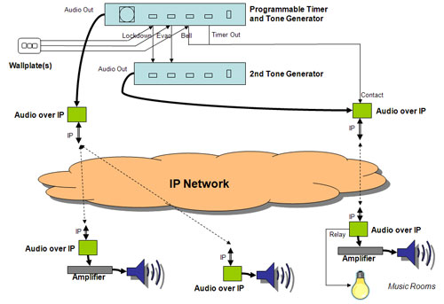

Slide 29
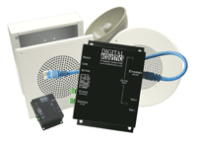
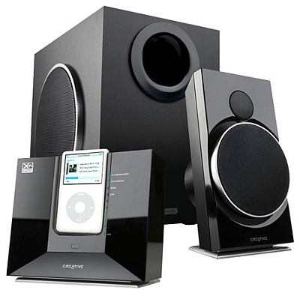
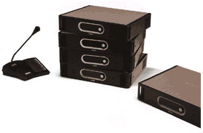
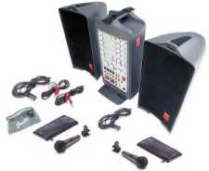
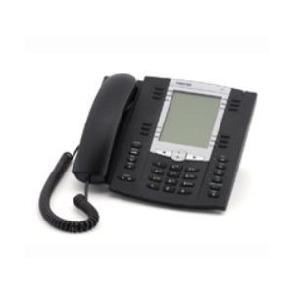
PUBLIC ADDRESS SYSTEM :- IP / Non IP BASED SOLUTIONS

Slide 30
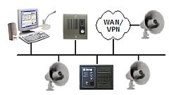
Campus-wide PA system:

Slide 31
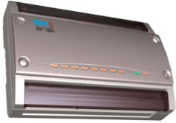

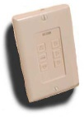


Security and Fire Protection System
LonWorks Auto Control Network
I/O Module
IR Sensor
Door Shutting Sensor
Fire Sensor
Ultraviolet Sensor
Emergency Alarm Switch
Function
Prevention strangers’ intrusion from doorway. All the sensors’ data are sent directly to the management centre.
Feature
Fire (heat) sensor, door shutting sensor, ultraviolet sensor, emergency alarm switch.
Protocol
EIA709.1 and EIA709.2
Previous Slide
Back-2-index
Next Slide

Slide 32

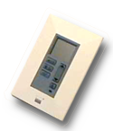

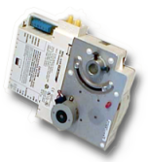
Air ventilation/Air Conditioning Monitoring &
Control and Remote Data Collection system
Lon works Auto Network Control
Power Meter
I/O Module
Indoor Temperature Detector
Gas Meter
Water Meter
Pulse Input
Hot Water Meter
Valve Controller
Function
Set up indoor temperature wind valve controller, configure multi functions and schedules for the hot water, tap water, electricity and gas etc. data auto collections.
Protocol
EIA709.1 and EIA709.2
Previous Slide
Back-2-index
Next Slide

Slide 33
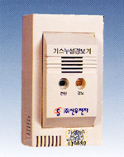


Gas Leakage Circuit Breaker
LonWorks Auto Control Network
I/O Module
Gas Leakage Detector
Alarm Light
Gas Circuit Breaker
Function
Gas leakage detector -> Turn on Alarm light and Gas circuit breaker
Feature
Guarantee to break gas leakage and send data to management system
Protocol
EIA709.1 and EIA709.2
Previous Slide
Back-2-index
Next Slide

Slide 34
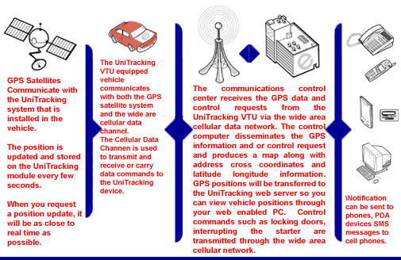
Asset Tracking Systems :
Previous Slide
Back-2-index
Next Slide

Slide 35
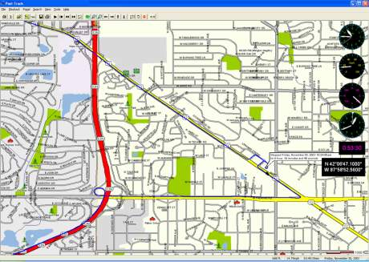
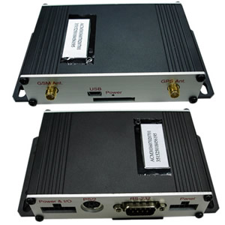
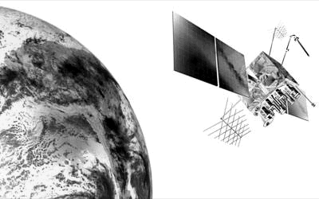
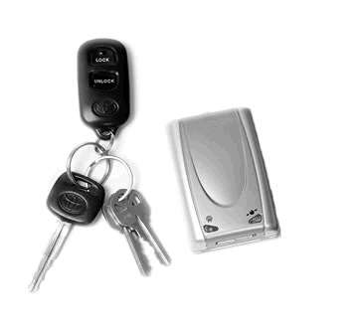
Vehicle Tracking Systems :
Previous Slide
Back-2-index
Next Slide

Slide 36
Website Solutions
Web site Design
Website Redesign
Website Maintenance
Domain registrations
Unlimited Hosting
Ecommerce Website Development
search engine optimization
Previous Slide
Back-2-index
Next Slide

Slide 37
Truly delivering technology……
Thank you for sparing your valuable time for knowing about our Company.
Previous Slide
Back-2-index
Next Slide

Slide 38
THANK YOU
Chennai Office Address
RG TECH Solutions
No: 32, V.M. Balakrishnan Street,
Jaffarkhanpet, Chennai-600 083.
Branch Office: Madurai, Coimbatore
Phone: +91-9442024068
Email : sethu@rgtechsolutions.in

